Slide 1
The following information is intended to support your facility’s vaccination education efforts.
Print and display the pages as is or customize them with additional information or your facility’s logo (space allotted in the top right corner of each slide).
The content can be used on bulletin boards, staff common areas, visitor reception areas, at staff or family council meetings and in mailings.
Bulletin Board Bundle:
Vaccines Are Safe, and They Work!
The information provided in this resource is based on vaccine information and guidance as of the package release date.
This material was prepared by Health Quality Innovators (HQI), a Quality Innovation Network-Quality Improvement Organization (QIN-QIO) under contract with the Centers for Medicare & Medicaid Services (CMS), an agency of the U.S. Department of Health and Human Services (HHS). Views expressed in this material do not necessarily reflect the official views or policy of CMS or HHS, and any reference to a specific product or entity herein does not constitute endorsement of that product or entity by CMS or 12SOW/HQI/QIN-QIO-0197-04/06/22

Slide 2
Vaccines Are Safe, and They Work!
Vaccines are studied before they are allowed to be used
A system is in place to continually monitor the safety of vaccines
Serious side effects from vaccines are rare
Vaccines imitate an infection, which activates the body's defense system
If you do get the infection, you are much less likely to die or get as sick
Vaccines prevent 4-5 million deaths globally every year
Vaccine Safety | Centers for Disease Control and Prevention
Immunization | World Health Organization

Slide 3
History Proves the Safety of Vaccines!
MMR (Measles,
Mumps, Rubella)
Respiratory Syncytial Virus (RSV)
Haemophilus
influenzae
Pneumococcal
Meningococcal
Diphtheria
Rotavirus
Shingles
Smallpox
Smallpox
Mumps
Polio
2000
1969
2001
1914
1948
1955
1971
1996
2006
2014
1796
1926
1938
1940s
1963
1967
1981
1985
1998
2020
2023
Tetanus
Measles
Rubella
HPV
Pertussis
Hepatitis B
Chickenpox
Hepatitis A
COVID-19
DPT (Diphtheria,
Pertussis, Tetanus
Timeline of Vaccines

Slide 4
Vaccines Prevent Disease, Hospitalization & Death
Chickenpox (Varicella) ​ | The varicella vaccine has prevented an estimated 91 million cases, 238,000 hospitalizations and 200 deaths.
Diphtheria​ | Historically there were 200,000 cases a year. Thanks to the vaccine, that number has dropped by 99.9%.​
Haemophilus Influenza Type B (Hib)​ | Hib disease is now uncommon. It occurs primarily in the under-immunized and those too young to have completed the primary vaccination series.​
Hepatitis A​ | Since the hepatitis A vaccine was first recommended in 1996, cases of hepatitis A in the United States declined dramatically.​
Influenza (Seasonal Flu) ​ | A recent study showed that among adults, flu vaccination was associated with a 26% lower risk of ICU admission and a 31% lower risk of death from flu compared with those who were unvaccinated.​
Measles​ | Very few people - about 3 out of 100 - who get 2 doses of the measles vaccine will still get measles if exposed to the virus.​
Mumps​ | Mumps cases in the U.S. declined by 99% after the introduction of the vaccine. ​
Pneumococcal Disease​ | Overall, the vaccine is 60% to 70% effective in preventing invasive pneumococcal disease caused by pneumococcal strains in the vaccine.
Polio​ | Poliovirus has been eliminated in the U.S.
Rotavirus​ | 40-50,000 hospitalizations each year are prevented by the vaccine.​
Rubella​ | The 1964-65 epidemic infected 12.5 million people. Today less than 10 cases are reported each year. ​
Tetanus​ | Cases have declined more than 95% and deaths have declined more than 99%​.
Pertussis (Whooping Cough)​ | Pertussis affects a lot fewer people today than before pertussis-containing vaccines became widely available in the 1940s.
COVID-19 | Vaccine effectiveness against severe outcomes has been demonstrated to be higher and more sustained than it is against symptomatic infection.
RSV | These new vaccines provide an opportunity to help protect older adults against severe RSV illness at a time when respiratory infections are likely to circulate.
Notes:
Chickenpox: Chickenpox Vaccine Saves Lives Infographic | CDC
Diptheria: Diphtheria | HHS.gov
Hib: For Clinicians: Haemophilus influenzae | CDC
Hep A: Hepatitis A - General Fact Sheet (cdc.gov)
Flu: Key Facts About Seasonal Flu Vaccine | CDC
Measles: Measles, Mumps, and Rubella (MMR) Vaccination | CDC
Mumps: Mumps | Cases and Outbreaks | CDC
PNA: Ask the Experts: Pneumococcal Vaccines (immunize.org)
Polio: Polio in the United States | CDC
Rotavirus: Rotavirus in the U.S. | CDC
Rubella: Rubella in the United States | CDC
Tetanus: Tetanus Surveillance | CDC
Pertussis: About Diphtheria, Tetanus, and Pertussis Vaccination | CDC
14. COVID-19: ﻿﻿﻿﻿﻿﻿﻿﻿﻿﻿﻿﻿﻿﻿﻿Effectiveness of Up-to-Date COVID-19 Vaccination in Preventing SARS-CoV-2 Infection Among Nursing Home Residents — United States, November 20, 2022–January 8, 2023 | MMWR (cdc.gov) ; Efficacy and Safety of COVID-19 Vaccination in Older Adults: A Systematic Review and Meta-Analysis - PMC (nih.gov)
15. RSV: CDC Recommends RSV Vaccine For Older Adults | CDC Online Newsroom | CDC

Slide 5
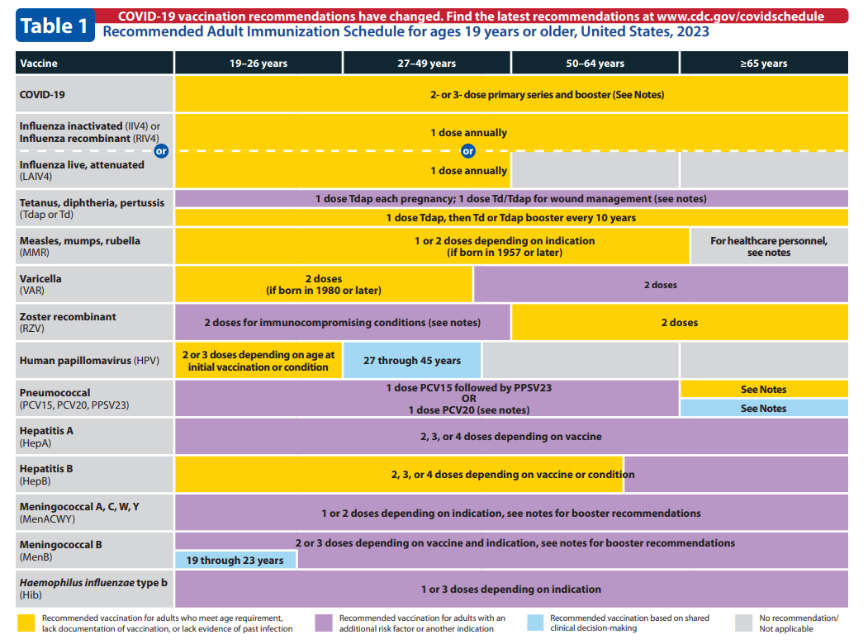
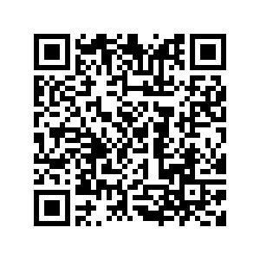
Recommended Immunization Schedule
= Recommended for residents in nursing homes
Recommended Adult Immunization Schedule | CDC

