Slide 1
The following information is intended to support your facility’s vaccination education efforts.
Print and display the pages as is or customize them with additional information or your facility’s logo (space allotted in the top right corner of each slide).
The content can be used on bulletin boards, staff common areas, visitor reception areas, at staff or family council meetings and in mailings.
Bulletin Board Bundle:
Starting or Supporting a Family Council
This material was prepared by Health Quality Innovators (HQI), a Quality Innovation Network-Quality Improvement Organization (QIN-QIO) under contract with the Centers for Medicare & Medicaid Services (CMS), an agency of the U.S. Department of Health and Human Services (HHS). Views expressed in this material do not necessarily reflect the official views or policy of CMS or HHS, and any reference to a specific product or entity herein does not constitute endorsement of that product or entity by CMS or 12SOW/HQI/QIN-QIO-0597-08/17/23

Slide 2
What is a Family Council?
Family councils are independently organized by family members or friends of residents
Residents’ families have the right to create a family council
Residents have the right to attend council meetings
Council meetings are educational or focus on issues that members want to address regarding their experience in nursing homes
Staff or other visitors may attend meetings if they are invited
Supporting a Council
Create a binder with educational materials for the family council.
This might include how families are notified of infectious diseases or emergencies.
It could include education on falls, sepsis or UTIs.
The binder may include handouts from the facility such as monthly newsletters or weekly activities.

Slide 3
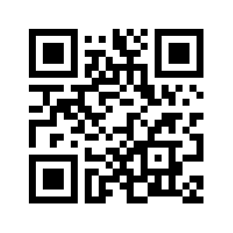
The Role of Our Family Council
Our team shares a strong partnership with residents, families and the family council to harness the strength of family and improve our residents’ quality of life.
Council members are invited to talk to any staff member – staff are open and ready to communicate and find helpful resources if needed.
Scan the QR code to access printable resources for family members on topics like flu shots, COVID-19 vaccination, UTIs and diabetes

Slide 4
Suggested Council Committees
Family councils may establish committees to focus on specific areas of interest
Birthday Committee: Recognizes resident birthdays
Hospitality Committee: Welcomes new residents, helps them settle in and meet other residents and staff. May also welcome guests.
Sunshine Committee: Reaches out to those who are sick or in the hospital. Sends get well or sympathy cards.
Volunteer Service Committee: Offers volunteer services in the home, such as water plants, organize activities, etc., or collects donations for local charities.

Slide 5
Our Facility Involves and Appreciates Residents, Family and Friends: Great Job!
A resident's sister helping with our vaccination clinic
<Insert pictures, events, numbers or add a sticky note and update it as needed. The examples shown can be deleted.>
Our speech therapist teaching family members how to safely feed their mother
CNAs teaching family how to use the wheelchair for an outside visit
The infection preventionist, teaching our family council about influenza

Slide 6
Nursing Home Responsibilities to a Family Council: Tag F565
Proactive Help
Provide private space, if available
Respond to questions or concerns in writing in a timely manner
Provide a staff member acceptable to the council who is willing to be a communicative leader to facilitate questions and responses
Make reasonable efforts to alert residents and families if a meeting is scheduled
Provide a list of speakers who could present helpful information to a family council.
This might be the infection preventionist, medical director, lead CNA or head of environmental services, for example.

Slide 7
Our Best Practices Commitment
Communication Best Practice: Ensure all staff are prepared in case they are approached with concerns or compliments by family or family council members.
Responsiveness Best Practice: Provide a response within 24 hours, even if it is not a full response. Sometimes an emergent response is necessary.
Protected Health Information Best Practice: Remain mindful of protecting residents' personal information when communicating with council members.
Meeting Best Practice: Offer education from knowledgeable frontline staff or outside speakers for each family council meeting.

Slide 8
How Councils and Facilities Partner
We understand your concern and strive to meet the needs of residents, but some have limitations in ability or medical reasons to not have a pitcher of water.
Our council has a concern that every resident doesn't have access to a pitcher of water.
Education about nursing facilities and elder care
Written communication of positives, concerns and ideas
Provide input for quality assurance and performance improvement activities around care
Involvement in events that help residents of the facility
We have some data we can share from our quality assurance and performance improvement (QAPI) work regarding this topic.

Slide 9
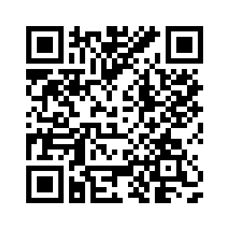
Plan, Do, Study, Act Cycle
<Fill in your own targets>
P
D
S
A
PLAN: Our Resident Family Council has asked that we increase outside activities for residents. We plan to increase outdoor activities to twice a month starting next month for three months.
DO: Did everything go as planned?
STUDY: Did we hit our goal? What did we learn?
ACT: What are our conclusions? What do we need to do differently?
Scan to access a downloadable PDSA worksheet

