Slide 1
The following information is intended to support your facility’s vaccination education and promotion efforts.
Print and display the pages as is or customize them with additional information or your facility’s logo (space allotted in the top right corner of each slide).
The content can be used on bulletin boards, in staff common areas, and at staff or family council meetings.
Bulletin Board Bundle:
Sepsis and Vaccination
The information provided in this resource is based on vaccine information and guidance as of the package release date.
This material was prepared by Health Quality Innovators (HQI), a Quality Innovation Network-Quality Improvement Organization (QIN-QIO) under contract with the Centers for Medicare & Medicaid Services (CMS), an agency of the U.S. Department of Health and Human Services (HHS). Views expressed in this material do not necessarily reflect the official views or policy of CMS or HHS, and any reference to a specific product or entity herein does not constitute endorsement of that product or entity by CMS or HHS. 12SOW/HQI/QIN-QIO-0573-08/02/23

Slide 2
Catch Up On Vaccines: Sepsis Matters!
What is Sepsis?
“Sepsis is the body’s extreme response to an infection.
It is a life-threatening medical emergency.
Without timely treatment, sepsis can rapidly lead
to tissue damage, organ failure and death.”
How Does Someone Become “Septic?”
Sepsis starts as an infection that gets into the blood stream, multiplies rapidly and travels quickly through the body.
The body responds by sending white blood cells, which causes extreme inflammation.
Source: Centers for Disease Control and Prevention

Slide 3
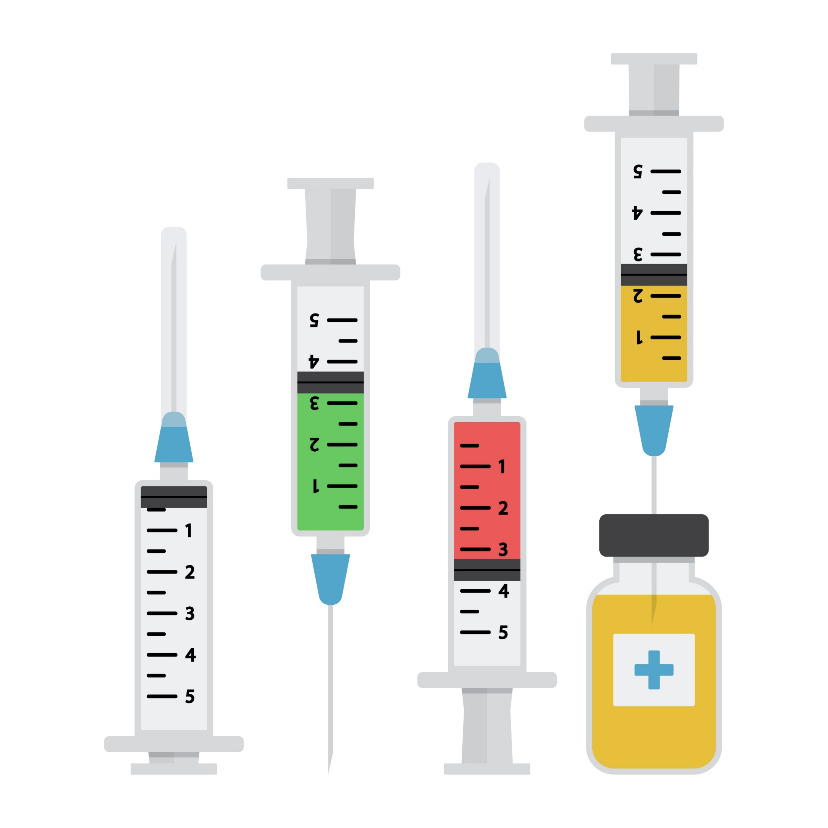
Infection Prevention is the Best Way to Prevent Sepsis
Vaccinations are important tools in the fight against infections
Vaccinations can prevent illness by killing the infection-causing organism or minimizing the impact of the illness
Vaccinations are much safer than hoping you will get the infection and develop immunity – you avoid the serious effects of the illness itself
Best Practices:
Obtain vaccination consent and history at admission
Incorporate vaccination training into all staff onboarding
If you can't find records, ask the prescriber if you can administer vaccines
Provide post-vaccination education and offer to answer questions the resident and/or family may have

Slide 4
Co-administer Vaccinations to New Admissions and at Vaccine Clinics
Vaccines Recommended for Older Adults:
COVID-19
Influenza
Pneumococcal
Note: Disparity with Vaccinations in Age>65:
Vaccine coverage highest for white adults (non-Hispanic)
Vaccine coverage lowest for poor adults
Looking for Vaccine Records?
• Primary care provider office patient portals • Usual pharmacy • Previous facility • State Immunization Registry
• Public health clinics • Veterans Affairs • Local hospital systems • Insurance records • Former employers • Ask the resident and family to help
Shingles
Tetanus
RSV
Vaccination Coverage Among Adults Aged 65 and Over: United States, 2015 Getting a Flu Vaccine and a COVID-19 Vaccine at the Same Time | CDC

Slide 5
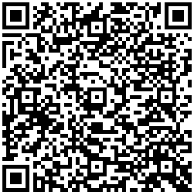
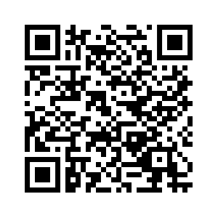
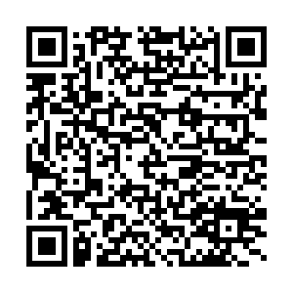
Vaccinate for Flu and Pneumonia to Avoid Sepsis
Pneumonia is the #1 cause of sepsis: 50% of sepsis cases
Pneumonia is the second most common cause of infection in nursing homes
Flu can lead to pneumonia
Pneumonia in NH residents may present as lethargy, confusion and falls, but also assess for more typical signs: cough, hypoxia, SOB, fever
1.3 million ED visits have pneumonia as a primary diagnosis
The Agency for Healthcare Research and Quality’s (AHRQ) Intramuscular Injections - Best Practices for Safe Vaccine Administration in Nursing Homes tool outlines best practices for safe vaccine administration
Scan to access the CDC’s Vaccination Coverage Among Adults Aged 65 and Over
Scan to access McKesson’s Pneumonia Resources

Slide 6
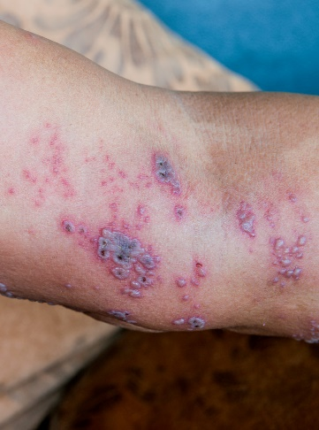
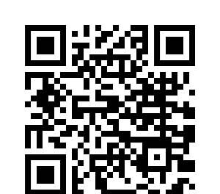
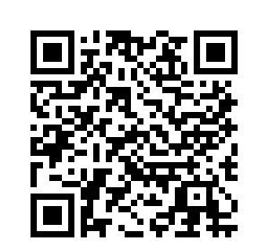
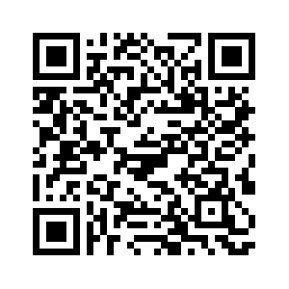
Shingles in Nursing Home Residents
The risk of shingles increases with age
The risk of complications, hospitalization and death from shingles increases with age
Postherpetic neuralgia (severe nerve pain from shingles) risk increases with age
33% of people in the U.S. will get shingles in their lifetime
The Shingrix vaccine is over 90% effective at preventing shingles
Incidence increases with age, 50% in those over 85
Mortality rate, mainly a risk for immunocompromised, is 5-15%
A COVID-19 infection increases the risk of shingles
Shingles can present with fever, chills, diarrhea, burning sensation, malaise, headache
Scan to access the CDC’s Shingles (Herpes Zoster) Vaccination webpage
Scan to access the CDC’s Shingles (Herpes Zoster) Clinical Overview
Scan to access the Cleveland Clinic’s Shingles webpage

Slide 7
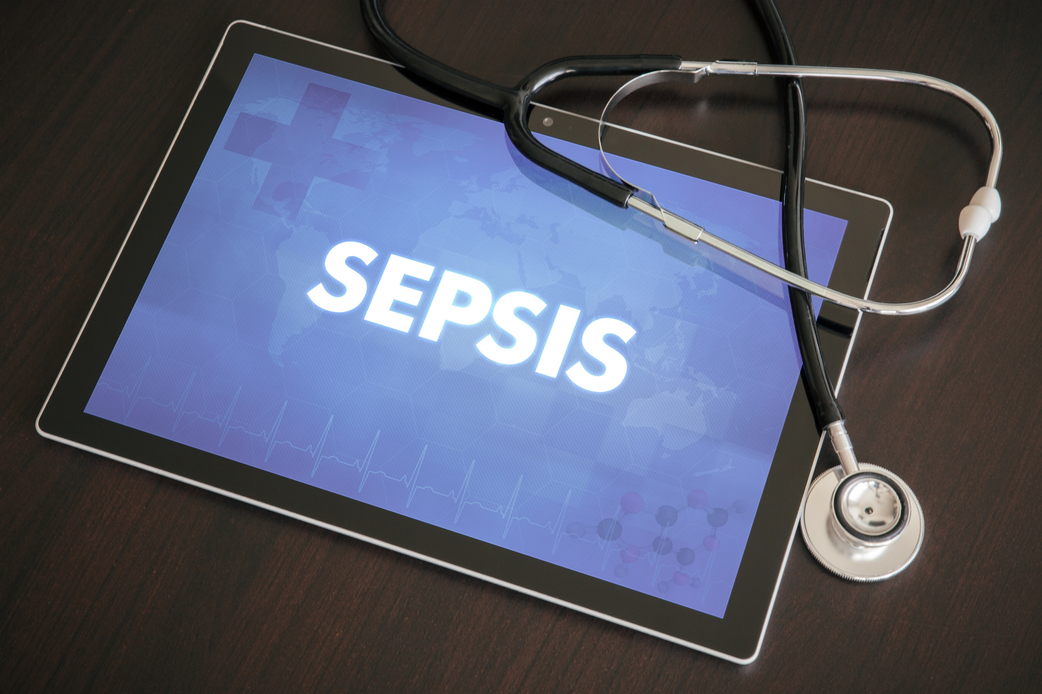
Vaccines Prevent a Cascade of Illnesses: Help Prevent Sepsis
Prevent debilitating illness from shingles or infected wounds from shingles to reduce the risk of infection and sepsis
Prevent pneumonia or severe pneumonia to reduce the risk of sepsis
Tetanus, a devastating illness from dirty wounds, is rare but it can cause pneumonia and sepsis
Prevent respiratory infections from influenza, which can lead to sepsis
Prevent severe illness from COVID, including secondary infections caused by COVID, which can cause sepsis

Slide 8
Conduct a Performance Improvement Plan
Step 1: Determine the Key Areas for Improvement:
Complete a medical records review for 8-10 residents who were transferred to the emergency department or admitted to the hospital with sepsis.
NOTE: You can choose a different number or timeframe based on your facility’s usual patterns of transfer and readmission. Select a meaningful number to help identify any trends.
Study documentation by the nurse and other staff. Review other areas, such as lab work, notes from the hospital and vaccination records. Note any diagnostic reasons or other patterns of interest (e.g., vital signs, staff involved, medical director, health disparities, time of day, unit, staffing, etc.).
Determine if there were missed opportunities that could have prevented the issue that led to the hospital transfer.

