Slide 1
The following information is intended to support your facility’s vaccination education efforts.
Print and display the pages as is or customize them with additional information or your facility’s logo (space allotted in the top right corner of each slide).
The content can be used on bulletin boards, in staff common areas, visitor reception areas, at staff or family council meetings and in mailings.
Bulletin Board Bundle:
Teambuilding Tools: Psychological Safety, Resilience & Communication
The information provided in this resource is based on vaccine information and guidance as of the package release date.
This material was prepared by Health Quality Innovators (HQI), a Quality Innovation Network-Quality Improvement Organization (QIN-QIO) under contract with the Centers for Medicare & Medicaid Services (CMS), an agency of the U.S. Department of Health and Human Services (HHS). Views expressed in this material do not necessarily reflect the official views or policy of CMS or HHS, and any reference to a specific product or entity herein does not constitute endorsement of that product or entity by CMS or HHS. 12SOW/HQI/QIN-QIO-0611-09/06/23

Slide 2
Psychological Safety Means You Feel Safe Asking Questions, Sharing Ideas & Learning from Mistakes
It is okay to:
Voice unfinished thoughts
Acknowledge a learning environment
Brainstorm out loud
Ask naïve questions
Disagree
If you have ever shared a problem that could become a disaster and found a supportive team around you, that is the experience of psychological safety.
I am so glad you brought this up so we can help her!
I noticed that too.
I think she is missing her bridge.
I thought I heard she was a vegetarian?
The new patient isn’t eating
Psychological safety on the healthcare team: Nursing Management

Slide 3
Hearing From the Team: A Useful Model
Stop, Start, Continue and Change Template
STOP | What are we doing in our organization that is not working? (Something we should STOP)
START | What should we put in place to improve our organization? (Something we should START)
CONTINUE | What is working well in our organization and should be continued? (Something we should CONTINUE)
CHANGE | What is working to some extent and would benefit from minor changes? (Something we should CHANGE)
Tip: Print this template and use it to guide huddles and meeting discussion.
Stop Start Continue Change Management Model: RapidBI

Slide 4
Resilience & Wellness
Dimensions of wellness are interconnected but don’t have to be equally balanced
You are resilient!
Resilience is “the process of adapting well in the face of adversity, trauma, tragedy, threats, or significant sources of stress—such as family and relationship problems, serious health problems, or workplace and financial stressors.”
– American Psychological Association (2012)
Physical
Spiritual
Emotional Health
Intellectual
Environmental
Social
Financial
Reach out: If you aren’t feeling resilient, reach out to a workplace buddy, your personal support system (family, friends, religious advisor, therapist), your employment assistance program or call 988 for support.
Occupational

Slide 5
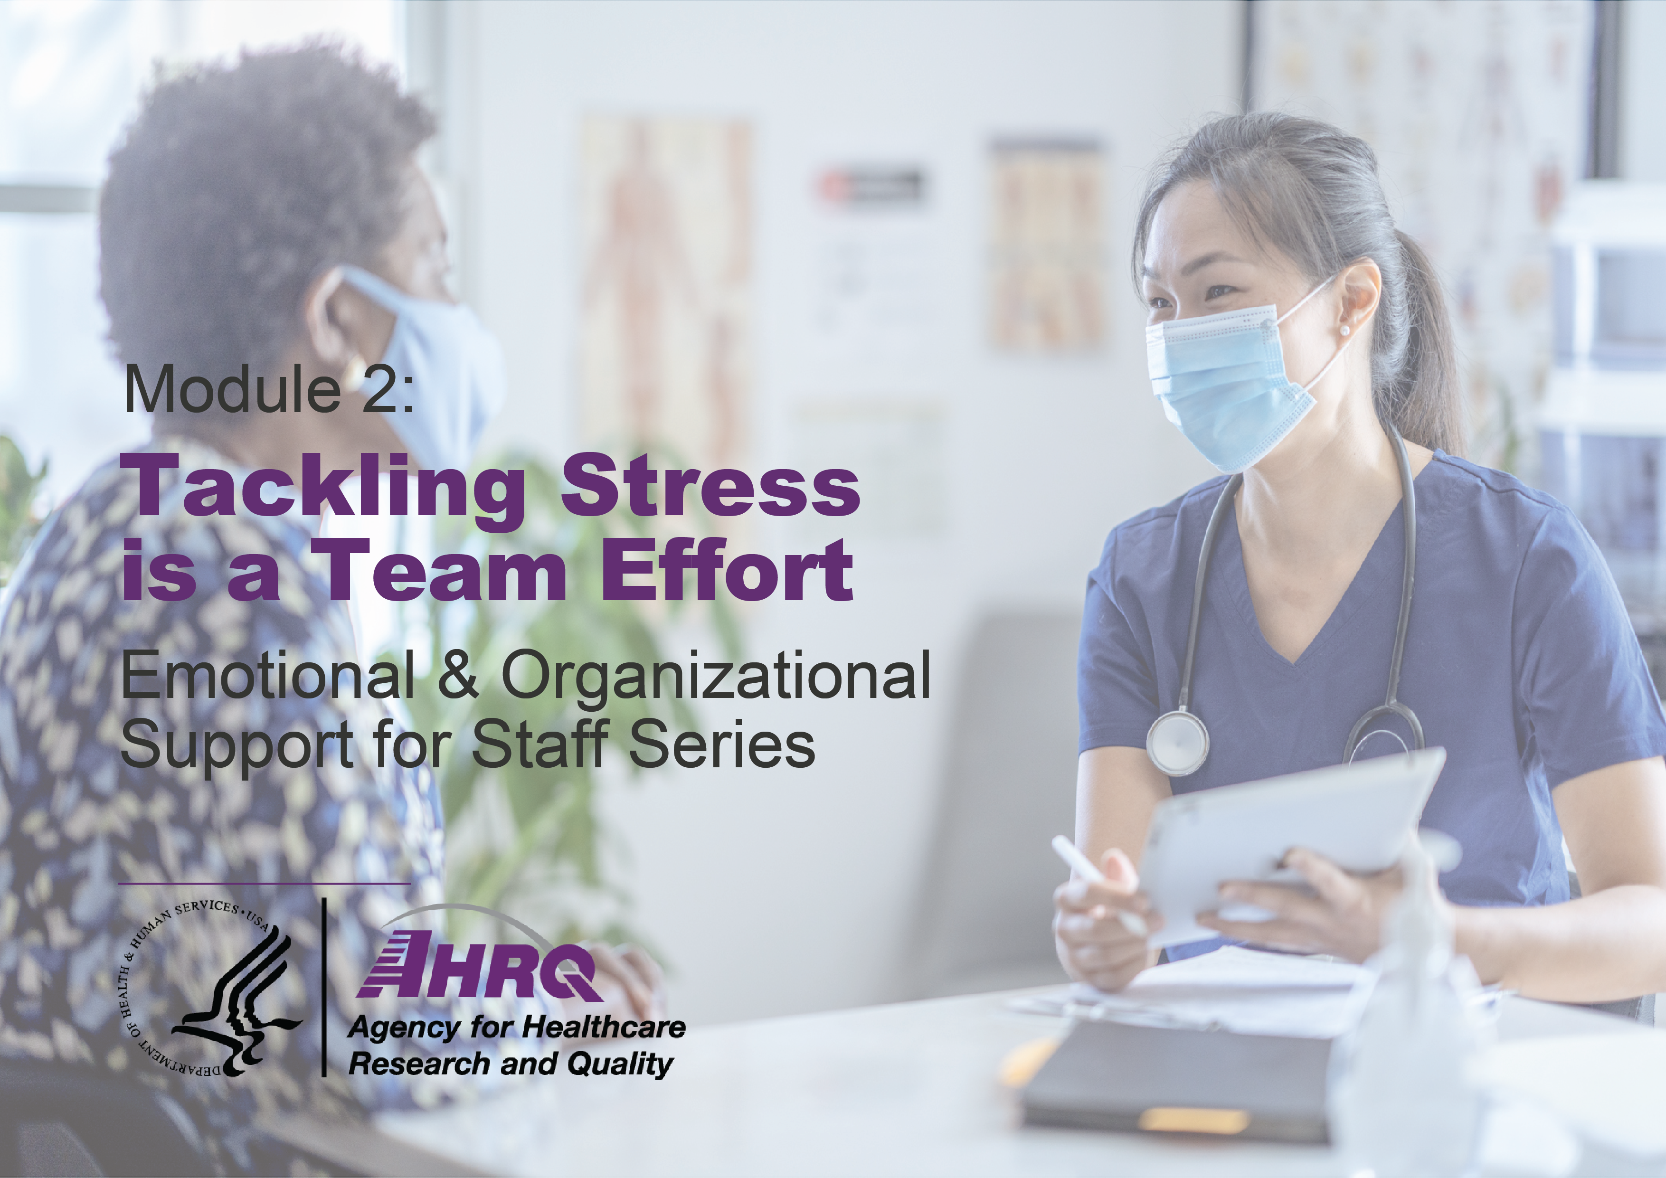
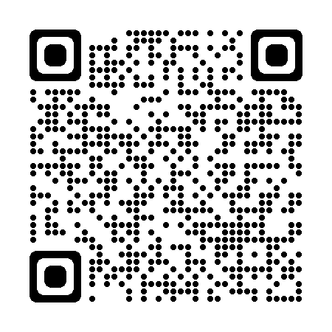
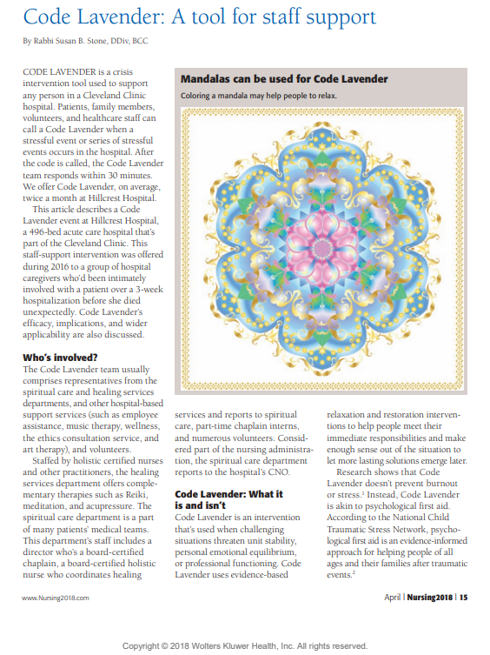
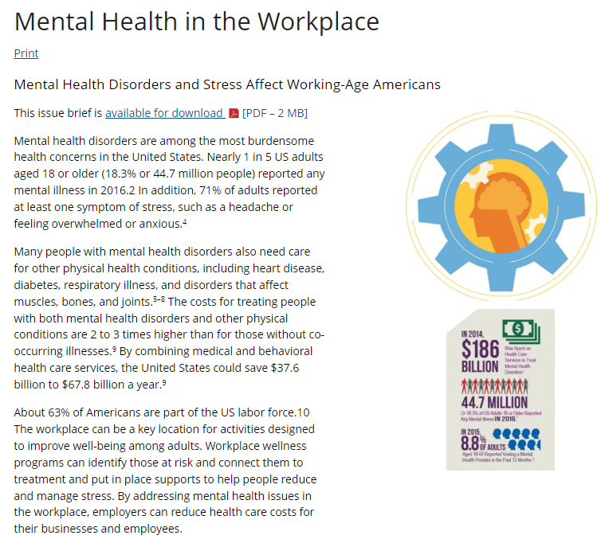
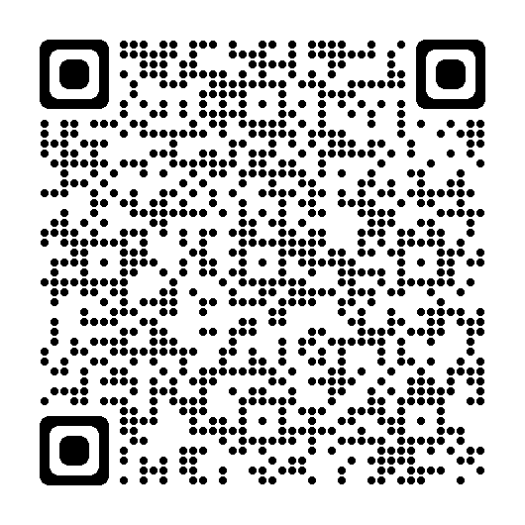
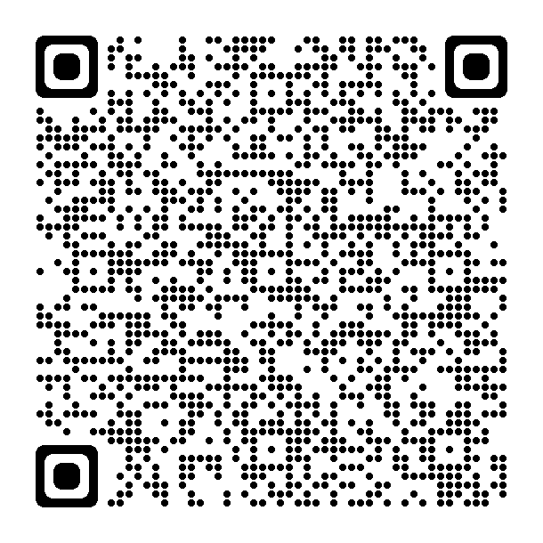
Supportive Video Modules and Staff Resources
5-Minute Learning Modules for Frontline Staff
Mental Health
in the Workplace
Code Lavender

