Slide 1
Introduction
Bulletin Board Bundle:
Five Vaccines to Feature for Staff Education
COVID-19, Influenza (Flu), Respiratory Syncytial Virus (RSV), Pneumococcal (Pneumonia) & Shingles
The following information is intended to support your facility’s vaccination education efforts.
Print and display the pages as is or customize them with additional information or your facility’s logo (space allotted in the top right corner of each slide).
The content can be used on bulletin boards, in staff common areas, visitor reception areas, at staff or family council meetings and in mailings.
The information provided in this package is based on vaccine information and guidance as of the package release date.
This material was prepared by Health Quality Innovators (HQI), a Quality Innovation Network-Quality Improvement Organization (QIN-QIO) under contract with the Centers for Medicare & Medicaid Services (CMS), an agency of the U.S. Department of Health and Human Services (HHS). Views expressed in this material do not necessarily reflect the official views or policy of CMS or HHS, and any reference to a specific product or entity herein does not constitute endorsement of that product or entity by CMS or HHS. 12SOW/HQI/QIN-QIO-0714-01/17/24

Slide 2
Five Vaccines to Feature for Staff Education
Assess type of vaccine needed (see resources)
Review special considerations/ contraindications, including those who are immunocompromised
Review dosing/administration guidelines (see resources)
Provide education specific to the vaccine
PNEUMONIA
COVID-19
SHINGLES
FLU
RSV

Slide 3
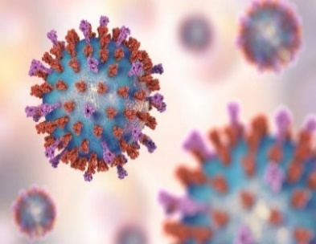
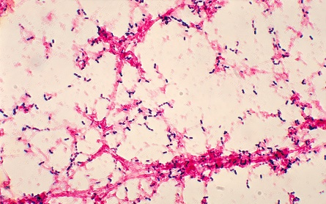
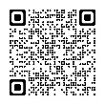
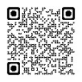
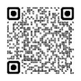
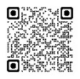
Vaccines and Frequency of Vaccines
COVID-19
1 dose of updated vaccine (you may need more than 1 dose)
Influenza
1 dose annually of Flublock Quadrivalent OR
Fluad Quadrivalent OR
Fluzone High-Dose Quadrivalent
Respiratory Syncytial Virus (RSV)
Over 60: 1 dose
RSVPreF3 (Arexvy)
OR
RSVpreF (Abrysvo)
Pneumococcal (Pneumonia)
65 and Over:
PCV20 or PCV21* (1 dose) OR if PCV15 dose, 1 dose PPSV23 1 year later
(2 doses, 1 year apart)
Shingles
50 and Over:
Shingrix:
2 Doses, 6 months apart
*New ACIP recommendations for RSV, COVID-19 and pneumococcal vaccines, plus updated flu vaccine | American Medical Association

Slide 4
Vaccines and Safety
Immunocompromised, also known as immunocompetence, immunosuppression or immunodeficiency, means having an impaired immune system.
People with certain conditions, such as cancer (including those persons undergoing treatment for tumors), chronic diseases such as asthma or other chronic lung conditions, diabetes, liver disease, kidney disease, HIV, etc. are considered immunocompromised.
People undergoing treatment with high-dose corticosteroids, alkylating agents, antimetabolites, transplant-related immunosuppressive drugs, or cancer chemotherapeutic agents are also considered immunocompromised.
Talk with your healthcare team about what vaccines are needed to keep both you and your residents/patients up to date.
Review your own or your resident’s/ patient's status for any needed vaccinations
Assess type of vaccine needed (see resources)
Review dosing/ administration guidelines (see resources)
Provide education specific to the vaccine

Slide 5
Who Needs the Pneumonia Vaccine and Which One? (for those without an immunocompromised health status)
No previous vaccine
PCV15 then PPSV23 ≥ 1 year later
PCV20 or PCV21*
PPSV23 only
PCV15 ≥ 1 year after PPSV23
PCV20 or PCV21 ≥ 1 year after PPSV23
PCV13 only
PPSV23 ≥ 1 year after PCV13
PCV20 or PCV21 ≥ 1 year after PCV13
PCV13 + PPSV23;
no PPSV23 after 65
PPSV23 ≥ 1 year after PCV13 and ≥ 5 years after PPSV23
PCV20 or PCV21(SCDM**) ≥ 5 years after last pneumococcal vaccine
**Shared Clinical Decision Making
PCV13 + PPSV23 after 65
SCDM: PCV20 or PCV21 ≥ 5 years after last pneumococcal vaccine
Kobayashi M, Pilishvili T, Farrar JL, et al. Pneumococcal Vaccine for Adults Aged > 19 Years: Recommendations of the Advisory Committee on Immunization Practices, United States, 2023. Morbidity and Mortality Weekly Report. 2023; 72(3): 1-39.
*New ACIP recommendations for RSV, COVID-19 and pneumococcal vaccines, plus updated flu vaccine | American Medical Association

Slide 6
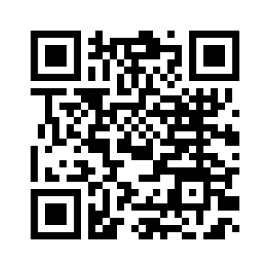
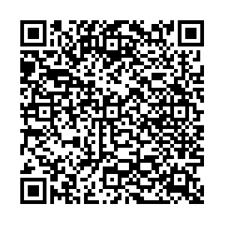
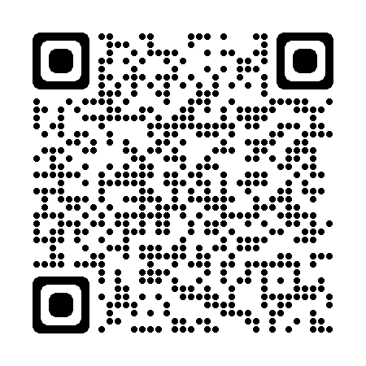
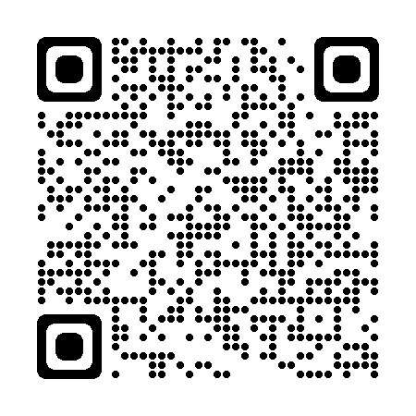
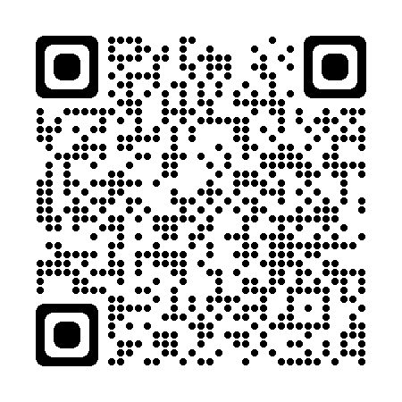
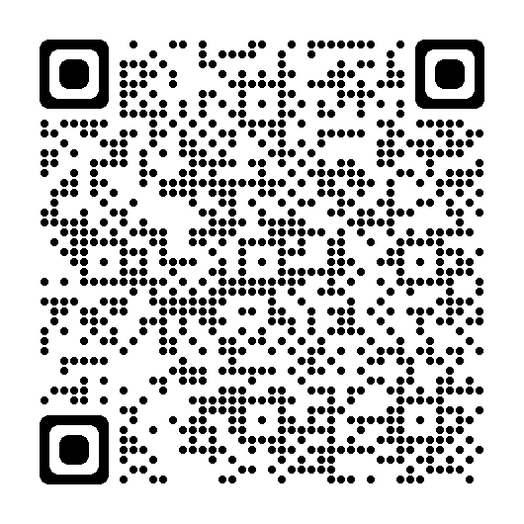
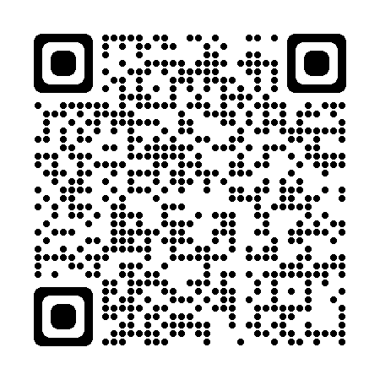
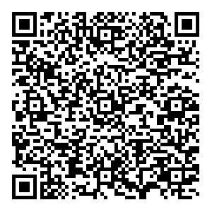
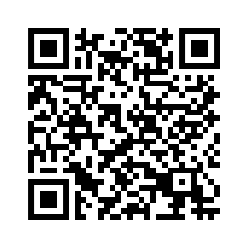
Vaccine Terms to Know & Resources
Immunocompromised Vaccine Resources:
People with Certain Medical Conditions and COVID-19 Risk Factors| CDC
COVID-19 Vaccines for People Who Are Moderately or Severely Immunocompromised | CDC
Adult Immunization Schedule, By Medical Indications | CDC
Inactivated flu vaccine: An influenza (flu) vaccine that does not contain any live influenza virus components.
Inactivated Influenza Vaccine Information Statement | CDC
Recombinant flu vaccine: This method of vaccine creation does not require an egg-grown vaccine virus and does not use chicken eggs in the production process. Flublock Quadrivalent is a recombinant influenza (flu) vaccine.
Vaccination Information/Schedule 2024:
2024 Recommended Immunizations for Adults Aged 19 Years and Older | CDC
The Adult Vaccine Assessment Tool | CDC
Vaccine Hesitancy/Misinformation Resources | HQIN
Your Health Can't Wait, Vaccinate! Resources | HQIN
New ACIP recommendations for RSV, COVID-19 and pneumococcal vaccines, plus updated flu vaccine | AMA
ACIP Vaccine Recommendations and Schedules | CDC

