Slide 1
Introduction
Customizable presentation template:
Sepsis Education for Residents, Family Members and Visitors
This presentation template is intended to support your facility’s sepsis education efforts.
Customize each slide’s content by adding information or your facility’s logo (space allotted in the top right corner of each slide).
To add any images or a logo, select “Insert>Pictures>This Device” and choose the file(s) you’d like to add.
Delete this instruction slide before sharing your final presentation.
This material was prepared by Health Quality Innovators (HQI), a Quality Innovation Network-Quality Improvement Organization (QIN-QIO) under contract with the Centers for Medicare & Medicaid Services (CMS), an agency of the U.S. Department of Health and Human Services (HHS). Views expressed in this material do not necessarily reflect the official views or policy of CMS or HHS, and any reference to a specific product or entity herein does not constitute endorsement of that product or entity by CMS or HHS. 12SOW/HQI/QIN-QIO-0770-04/17/24

Slide 2
Sepsis Education for Residents, Family Members and Visitors
Notes:
Welcome to today’s talk on sepsis. My name is XXXXXX and my role in the nursing home is XXXXX. I am happy to share this information with you so that we can all help residents avoid sepsis.

Slide 3
Objectives
Understand the basics of sepsis in older adults
Identify the risks of sepsis in nursing home residents
Gain knowledge about preventing sepsis
Brought to you by Health Quality Innovators (HQI) and Your Facility Leaders

Slide 4
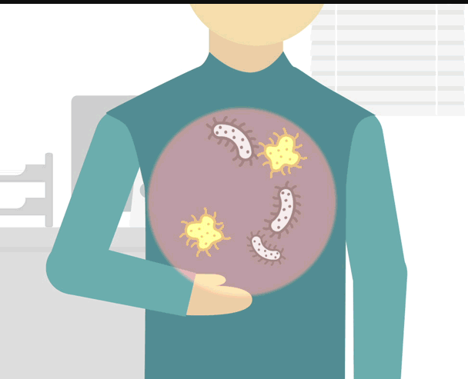
Sepsis: An Extreme Reaction to Infection
ANY infection can lead to sepsis
Why does it happen
Sometimes the infection fighting process gets out of control and turns on the body instead of fighting the infection
Some infections that can lead to sepsis:
Lung infections: colds, pneumonia, influenza, RSV
Bladder, kidney and urinary tract infections
GI tract infections like C. diff
Bloodstream infections that come from wounds, skin tears or bone infections
Endocarditis: infection of heart lining
Click on the image to watch a brief CDC video
Sepsis is sometimes called blood
poisoning. If you are worried about
sepsis, report your concerns so that
staff can assess, get help and educate.
Notes:
You may have heard about sepsis or blood poisoning before. Today we want to give you information and tools to help prevent sepsis. Sepsis happens when someone has an infection, any infection, and the mechanisms in the body that usually fight infection turn on the body. This can cause someone to get ill quickly, as their vital organs are affected. What we mainly see in our facility, because the people who live here are older and frailer, is infections from respiratory infections, like pneumonia, urinary tract infections and sometimes infections from skin openings.

Slide 5
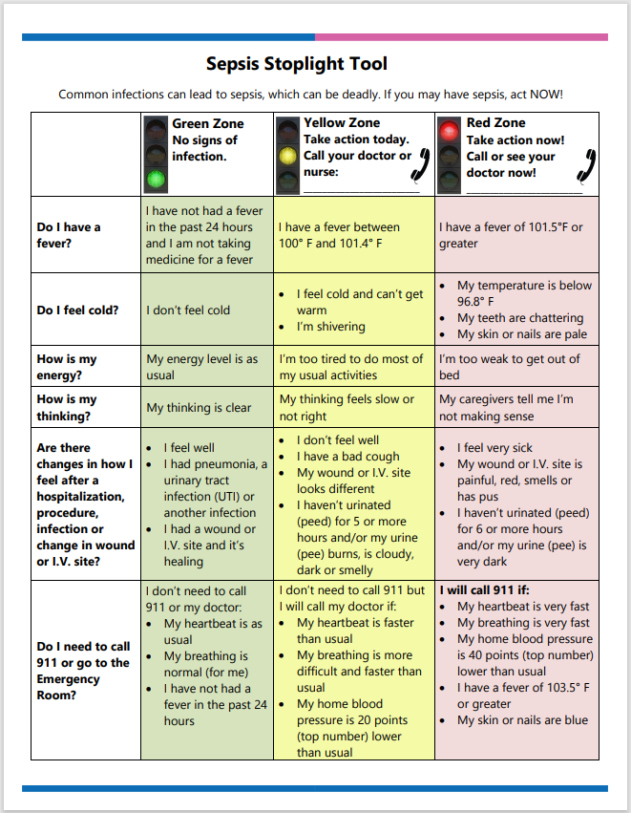
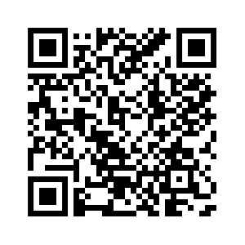
Sepsis Stoplight Tool
Sepsis is the body’s extreme, life-threatening response to an infection
Anyone can get sepsis, but the following are more likely to get it:
Adults aged 65 years or older
People with weakened immune systems and people with recent severe illness or hospitalization, including due to severe COVID-19
People with chronic medical conditions, such as diabetes, lung disease, cancer and kidney disease
Download the Sepsis Spotlight Tool
Notes:
Today we want to give you tools and information about sepsis and this stoplight tool is one you may see. If someone answers in the yellow or red about fevers or shortness of breath, etc., we want to take action by calling for help right away. We have some handouts for you available** People who live in nursing facilities are more at risk because their immune system might not be as strong simply because they are older or because they have become more ill through a recent hospitalization for any reason, but especially one for infection. It is common for people in nursing homes to have several chronic illnesses and these also increase the risk for sepsis

Slide 6
Sepsis Symptoms: Notice and Report
Fever OR low temperature
Shivering
Confusion or disorientation
Difficulty breathing
Clammy or sweaty skin
Body pain
A feeling of discomfort and/or doom
Low output of urine
High heart rate, weak pulse or low blood pressure
Dizziness
Medical treatment is required to recover from sepsis.
Sometimes hospitalization is required to recover from sepsis.
Notes:
Like the stoplight tool states, these can be symptoms of sepsis: fever or low temperature, shivering, confusions, difficulty breathing, clamminess, sweating, pain, a feeling of doom, low urine output, a high heart rate, weak pulse, a low blood pressure, dizziness. To recover from sepsis medical treatment is required, some residents and families may have chosen comfort care and our staff is experienced with taking care of residents who have made this choice. For people who choose to go to the hospital, we will communicate our concerns about sepsis with the emergency transportation service and with the emergency department and send records with the resident.

Slide 7
The TIME Model
Being confused does not mean someone has an infection, but let staff know if you notice confusion.
The TIME Model | Sepsis Alliance
Notes:
That might seem like a lot to remember, so you can use this TIME model to help remember the symptoms, Temperature, Infection, Mental decline and Extremely ill. It is very important to remember that a risk for sepsis is overtreating infections with antibiotics. Antibiotic guidance has changed over the years based on research that shows it is best to use the right antibiotic for the right length of time only when it is needed.

Slide 8
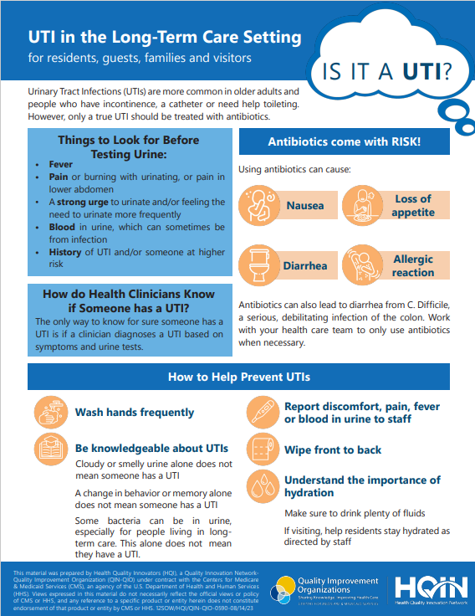
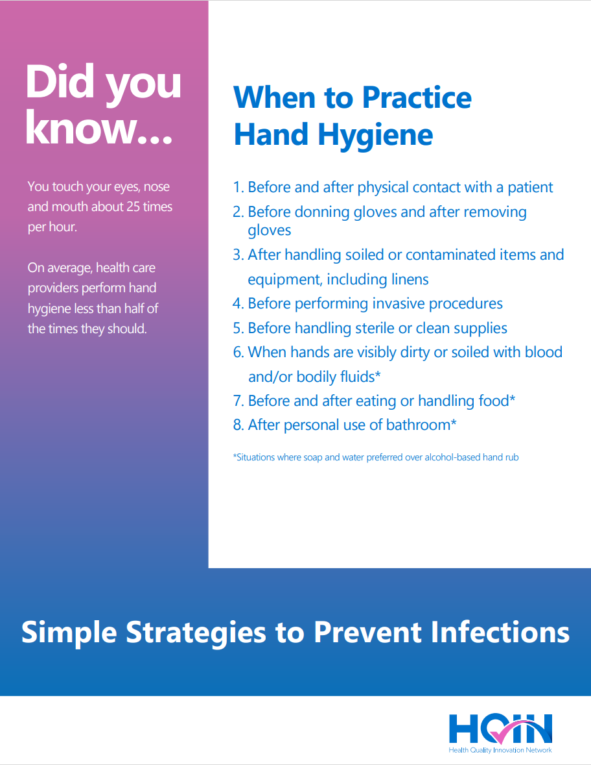
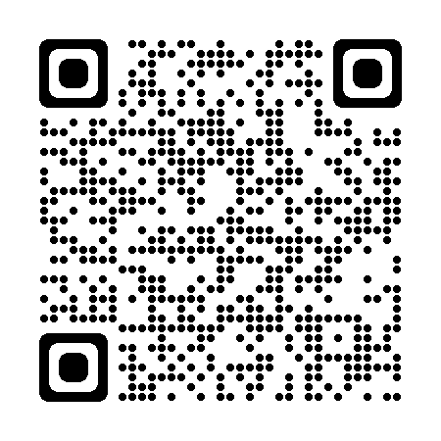
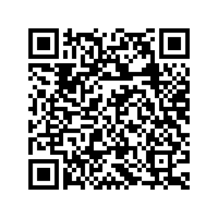
Preventing Sepsis: Core Strategies
Handwashing thoroughly and frequently
Vaccination to prevent infections such as pneumococcal, shingles, COVID-19, influenza, tetanus
Nutrition that is as good as possible, given any dietary limitations
Antibiotics only when needed and ordered, most people who live in nursing homes have bacteria in their urine, but this does not mean they have an infection
Download UTI in the Long-Term Care Setting
Download Simple Strategies: When to Practice Hand Hygiene
Notes:
Just like having bacteria in urine doesn't always mean a UTI, a person can have bacteria in other place, like stool and not have an active CDiff infection. What we also know is that good handwashing helps a lot.

Slide 9
Breaking the Chain of Infection
Washing your hands is the single best way to stop the spread of germs.
Break the Chain of Infection with Better Hand Hygiene | HQIN

Slide 10
The Value of Vaccines
Vaccinations are important tools in the fight against infections
Vaccinations can prevent illness by killing the infection-causing organism or minimizing the impact of the illness
Vaccinations are much safer than hoping you will get the infection and develop immunity – you avoid the serious effects of the illness itself
Infographics and Resources | Viswanath Lab (Harvard TH Chan School of Public Health)
Notes:
We have COVID, RSV and pneumococcal vaccines available in our facility for residents. Seasonally, we also have the flu vaccine available. Don't wait, get vaccinated to prevent these illnesses.

Slide 11
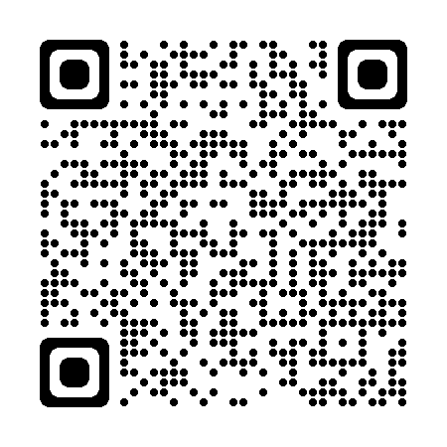
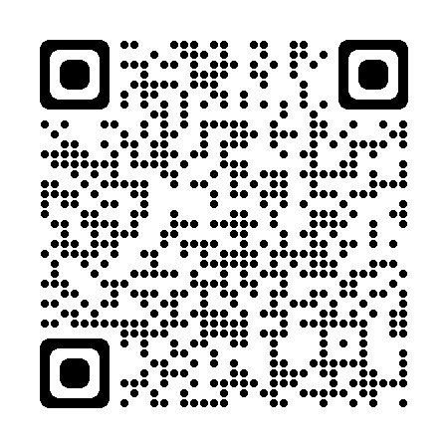
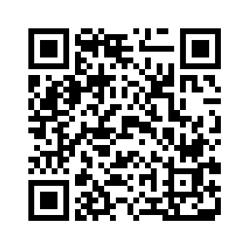
Vaccines Help Prevent Sepsis
Learn More About How to Stop Sepsis
Vaccines are available to prevent pneumonia
Pneumonia is the #1 infection that causes sepsis
Pneumonia is the second most common cause of infection in nursing homes
Flu, COVID-19 and RSV can lead to pneumonia; vaccines are available for each of these illnesses
Typical symptoms of pneumonia: cough, shortness of breath, low oxygen levels, fever
How can I get ahead of sepsis? | CDC
Protect yourself from pneumonia | HQIN
Protect yourself from the flu | HQIN
Protect yourself from COVID-19 | HQIN
Protect yourself from RSV | HQIN
Notes:
Pneumonia is a common infection in nursing homes that can lead to hospitalization and or sepsis. The CDC recommends several vaccines to help with respiratory illnesses and we are happy to provide them or help make an appointment for your loved one. To close, I want to leave you with this message that washing hands and vaccines can help prevent sepsis. Reporting symptoms you might notice to staff can help with earlier treatment and decision making.

Slide 12
Questions?
Learn More About How to Stop Sepsis
Notes:
Thank you for your attention. Are there any questions?

Slide 13
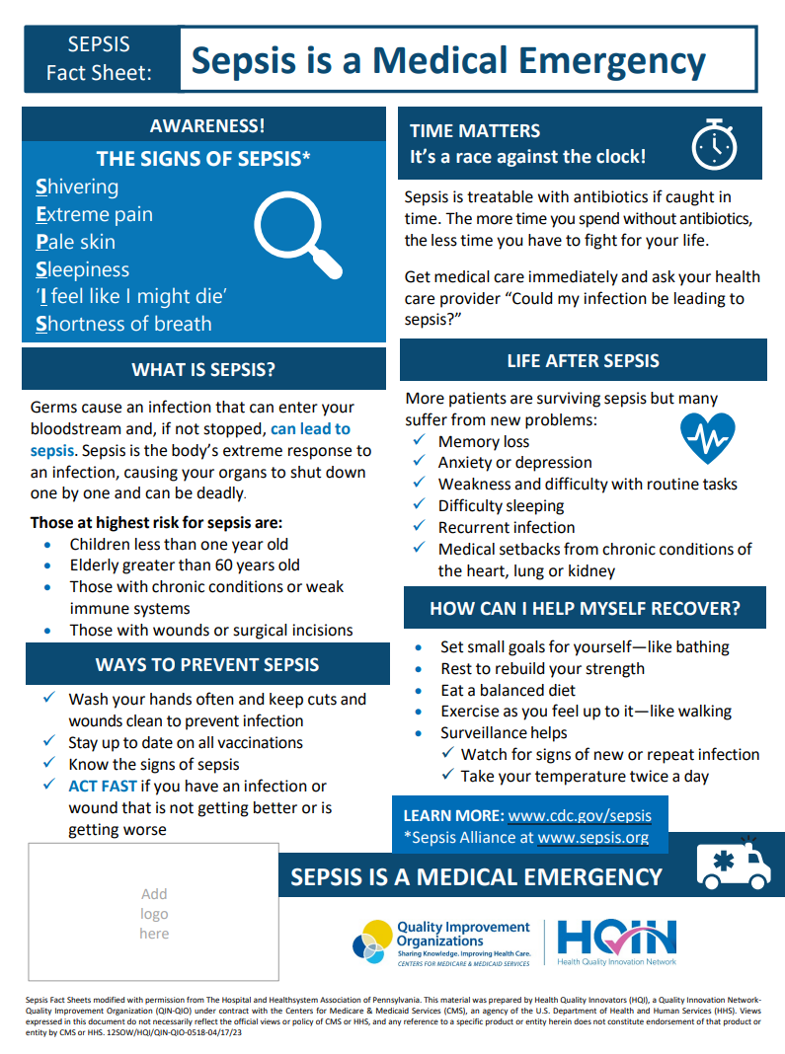
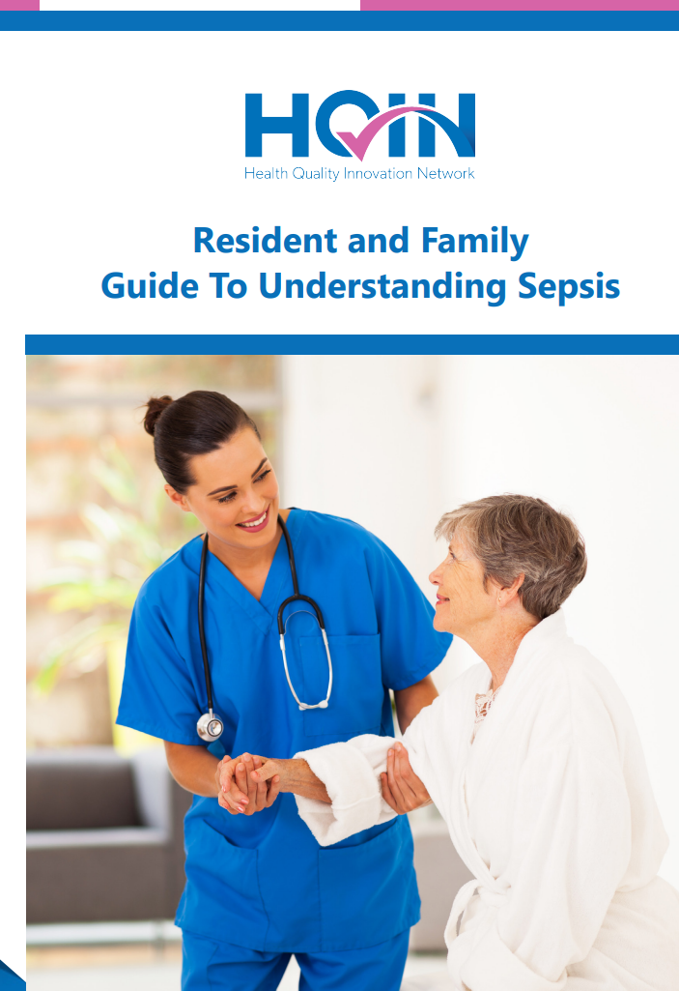
Resources & Terms to Know
Sepsis Spotlight Tool | HQIN
A Guide to Understanding Sepsis | HQIN
Resident and Family Guide to Understanding Sepsis | HQIN
UTI in the Long-Term Care Setting | HQIN
Protect Yourself from Pneumonia | HQIN
Protect Yourself from COVID-19 | HQIN
Protect Yourself from Respiratory Syncytial Virus (RSV) | HQIN
Sepsis is a Medical Emergency Fact Sheet | HQIN
When a Loved One Has Sepsis | Sepsis Alliance
Faces of Sepsis | Sepsis Alliance
Patient Sepsis Information | CDC
Sepsis and Aging | Sepsis Alliance
Sepsis Information in Spanish | Sepsis Alliance

