Slide 1
Health Quality Innovation Network

Slide 2
Infectious Disease Tabletop Exercise: Norovirus
[Insert exercise date]
[Insert any additional information you’d like to have on the title slide]

Slide 3
Welcome and Introductions
[Name]
[Title]
[Organization/Jurisdiction]
[Name]
[Title]
[Organization/Jurisdiction]

Slide 4
Exercise Schedule
Welcome and Introductions
Exercise Schedule
Exercise Overview
Exercise Objectives
Exercise Objective Guidelines
Module 1: Exposure and Mitigation
Break
Module 2: Treatment and Prevention
Hotwash
Break
Closing Remarks

Slide 5
Exercise Timeline
Event | Timeline
Welcome/Overview/Objectives | 15 Minutes
Module 1: Exposure and Mitigation | 70 Minutes
Break | 10 Minutes
Module 2: Treatment and Prevention | 45 Minutes
Break | 5 Minutes
Hotwash | 15 Minutes
Closing Remarks and Evaluations | 15 Minutes
Total Time | 3 hours

Slide 6
Exercise Overview
Purpose: Prepare [your organization/jurisdiction name] to review and assess our [Insert plans that could be reviewed given the topic]; identify gaps and issues; and recommend solutions and mitigation strategies.
Scope:
This is a 3 hour discussion-based exercise
Following an overview of the scenario, participants discuss plans, policies and procedures of infectious disease outbreak. The focus of the discussion should be toward the development of a more resilient and prepared facility.
Discussion questions are organized based around two core capabilities:
Response to an infectious disease outbreak
Prevention of a repeat outbreak

Slide 7
Exercise Objectives
Review methods for maintaining situational awareness by providing decision-makers with relevant information and regular status updates throughout an infectious disease outbreak.
Discuss strategies to provide life-sustaining services and to minimize health impacts to residents of a long-term care facility during an infectious disease outbreak.
Evaluate emergency preparedness policies against a scenario to pursue improvement and efficiency.

Slide 8
Exercise Guidelines
Our desired outcome from this exercise is [Insert organization-/ jurisdiction-specific outcome(s).]
This is an open, no-fault environment. Varying viewpoints, even disagreements, are expected.
Base your responses on current guidance and plans, policies, procedures, capabilities and resources.
Consider different approaches and suggest improvements.
There is no “hidden agenda,” nor are there any trick questions.
[Insert additional guidelines as appropriate.]

Slide 9
Module 1: Exposure and Mitigation

Slide 10
Scenario Overview
It’s November 15th, a Friday, at 8:00 a.m. Your facility is at 80% occupancy. You’ve heard of a rise in Norovirus case rates in the population, but so far, you’ve not been concerned with any threat to you or your residents.
Around 9:00 a.m., one of your nurses reports some concerns over two residents she took care of while doing rounds in the morning. She states that the residents had told her they’d had diarrhea for the last day. The other nurse she’s speaking to mentions that she had a few residents with the same issue yesterday.
You, the infection preventionist, review charts and see if any other cases of diarrhea have been reported. You find that there have been numerous reports of GI symptoms including diarrhea, abdominal pain, and decreased appetite. You look up from the chart and sit back, deciding what to do next…

Slide 11
Discussion Questions: Exposure and Mitigation (1/3)
Who is responsible for leading the response to an infectious disease incident?
Will you activate your incident command team? What positions will you activate?
Provision for Exposure:
  What signs and symptoms are seen with Norovirus?
  What are the gold standards for testing for Norovirus? Diagnosis?
  Where will you put residents that have had significant exposure/exhibit symptoms?
  What type of isolation is required for Norovirus patients?
Notes:
This should be the administrator on call or in house. However, any response is better with a team.
It would be prudent to do so. This should be your second step after calling the administrator on call. After this, the decision should be what positions you want to fill in the NHICS structure. Suggestions would be Incident Commander, Logistics Chief, Operations Chief, Safety Officer, Medical Director/Specialist (this could be your infection preventionist), and PIO. Your Medical Director would be a great resource to bring in. This individual can provide expertise in symptom management as well as treatment. In addition, if a transfer out of the facility is necessary it will be integral to have MD-MD follow up. Lastly, the Medical Director can provide clinical insights to the family and residents.
Provision for Exposure:
Symptoms- abdominal pain, fever, nausea/vomiting, diarrhea, muscle aches
Testing for Norovirus involves obtaining a stool sample and sending to the lab to test for rNA. Diagnosis is usually made clinically after reviewing differential causes and symptoms. Foodborne illness usually only last 24 hours. If symptoms occur longer than this it is likely a viral gastroenteritis like Norovirus.
Even if you’re uncertain whether the residents have Norovirus, exposure places anyone at risk as Norovirus is highly contagious. It would be best to quarantine these patients in their rooms/apartments and then make a list of rooms that have potential infected patients. If quarantine isn’t done, then ensure residents utilize masks (preferably N95) and use good hand hygiene.
Enteric Isolation Precautions

Slide 12
Discussion Questions: Exposure and Mitigation (2/3)
4. Provision for Exposure Continued:
  What Personal Protective Equipment or contact precautions are required when caring for patients with suspected Norovirus?
  If you have residents that are asymptomatic, do they need to be quarantined?
  What positions in the Nursing Home Incident Command System structure should be utilized on your incident command team?
  Do you have enough staff to care for patients if some staff members need to be quarantined? What are your staffing back measures?
Notes:
4. Provision for Exposure Cont’d:
Contact precautions- gloves, hand hygiene (with soap and water) pre/post patient care, gowns.
Asymptomatic residents do not need to be quarantine, but it would be wise to encourage limited physical contact with others and using frequent hand washing.
This was covered in a previous question.
If you do not already, consider reaching out to staffing agencies and establish a contract as needed to supplement staffing. In this scenario, staff members could also need to be quarantined which would affect operations and logistics.

Slide 13
Discussion Questions: Exposure and Mitigation (3/3)
5. Communications:
  Will you use a Public Information Officer (PIO)? What is the advantage of a PIO?
  Who will you send messaging to regarding this incident among staff, residents and families? Will you notify the health department?
  What provisions for notification to, or communications with, family members will you make? Do you have template messaging for events? In your command structure, did you consider a Public Information Officer?
  How will results be shared with those that are tested?
6. Security for the facility: What actions would need to occur to secure the facility and/or the portion of the building where potentially infected residents are?
7. How will you mitigate needing to transport patients to the hospital?
Notes:
5. Communications:
Use of a Public Information Officer would be highly recommended. A PIO can work on communication policy, templates, and methods for the duration of the event. Keeping families, residents, media, and the public abreast of the situation and well informed can keep you from dealing with emotional responses in addition to the incident.
Messaging should be targeted towards families, residents, media, and public as needed. In addition, lines of communication should be started with the local health department for their assistance and situational awareness.
Establishing a PIO will allow you to set up designated times when messaging will occur. Creating templates for messages needed during an event ahead of time will speed the communication process and alleviate stress.
Consider staffing some persons under the PIO to be utilized to communicate updates
6. Security for the facility- Consider upstaffing an security you currently have. In addition, the health department could help navigate conversations with local law enforcement who could help during an emergent need in security.
7. Consider triaging those patients you are most concerned for regarding Norovirus. For your more acute residents, it might help to establish contact with the facility or patient’s physician to get standing orders a head of time for symptom management. This way, you can treat the resident’s symptoms quicker and avoid decompensation. (Think fever and respiratory distress).

Slide 14
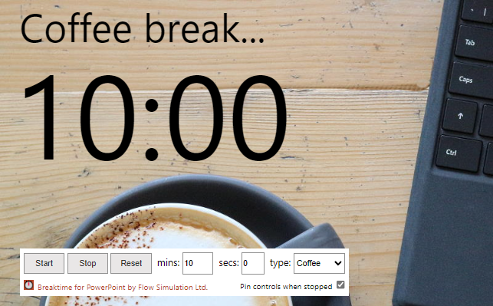
Break

Slide 15
Module 2: Treatment and Prevention

Slide 16
Scenario
There have been new developments. The results of your contact tracing have revealed 6 residents and 2 staff that have been exhibiting GI symptoms. The 6 residents are all individuals who have significant exposure to each other. The staff members worked closely with these residents. They both called out sick 2 days ago with GI symptoms.
You quarantine the 6 residents in their rooms and post enteric contact signs on the doors pending diagnostic tests sent to the lab.

Slide 17
Scenario
List of Residents with suspected Norovirus:
72 year old male, mild diarrhea, no abdominal pain, reduced appetite.
50 year old female, febrile, poor intake/output, diarrhea, abdominal pain
64 year old female, afebrile, abdominal cramping, nausea and diarrhea.
80 year old male, afebrile, abdominal pain, some nausea, loose stools
69 year old female, recent dx pneumonia, on ABX, 1 week into a 2-week regimen, diarrhea
82 year old male, febrile, hasn’t had any intake in the last few days, lethargic, diarrhea
Notes:
Resident #2 and #6 are likely to need more acute care. Transporting them to the hospital could prevent decompensation.

Slide 18
Discussion Questions: Treatment and Prevention (1/3)
Provision for Prevention:
What considerations do you have that would cause a transfer of a patient to an acute care facility? Which of the 6 patients would need to be transferred to an acute care facility to prevent decompensation and further testing?
In the context of a Norovirus outbreak, what contingency plans are in place to ensure continuity of care and minimize disruptions to essential services within the nursing home?
  What plans do you have for medication adherence with residents who have more limited contact with healthcare providers and may have memory care issues?
What measures are taken to ensure proper hygiene within the nursing home, particularly in shared spaces where residents and staff congregate, to minimize the risk of Norovirus transmission?
  Do you have the ability to feed residents in room? Disposable utensils and dinnerware?
What cleaning and environmental services actions need to take place? Do you know what types of wipes can be used to clean surfaces with Norovirus exposure? How long do those cleaning agents need to be effective?
Notes:
Provision for Prevention:
Residents that are at risk for decompensation related to altered mental status, fever, and cardiac issues should be monitored. These residents could become worse and need intervention that is not available at the facility. A prevention tactic would be to obtain standing orders for symptom management and prophylaxis. Of the 6 patients, #2 and #6 are the most likely to decompensate so would be the best candidates for transfer out to an acute care facility.
Consider a staffing agency contract if not already established. In addition, it would be beneficial to have internal surge plans for recalling staff, extending shifts, adjusting staffing ratios, and converting administrative staff into patient care techs as needed. In addition, consider closing down the facility to new admissions or transfers to reduce workload and exposure risk.
Consider visual aids in the living space of the residents that remind them to take their medications. In addition, consider ways to encourage hydration.
3. Post signs around the building encouraging hand washing with soap, education on cleaning surfaces, and how to stay hydrated.
4. Germicidal wipes and cleaning products will need to be used in/out for equipment that enters/exits the resident’s room. Particularly items the resident touches frequently. Consider using disposable plates, utensils, and trays that can be disposed of in the resident’s room and then bagged up. There are several products that are effective against a host of diseases including norovirus and clostridium difficile. These cleaning products range from wipes to sprays with variable contact time. You can reference the EPA website for a comprehensive list of products. EPA Product List - https://www.epa.gov/pesticide-registration/epas-registered-antimicrobial-products-effective-against-norovirus-feline

Slide 19
Discussion Questions: Treatment and Prevention (2/3)
Provision for Prevention Continued:
5. Do you have education/training available for staff members caring for residents with suspected Norovirus?
  What topics should staff be trained on?
6. What protocols are in place for the timely and effective maintenance of medical equipment and environmental services to minimize the risk of cross-contamination and infection transmission within the nursing home?
7. How will you keep families abreast of updates on their family members?
Notes:
Provision for Prevention Cont:
5. Training can be helpful especially if made ahead of time. This allows untrained individuals to become familiar with equipment and processes quickly. An example being how to wear an N95 mask or how to don a contact gown.
Decontamination, PPE uses and types, how to start the generator, how to troubleshoot ventilators, etc.
6. Having protocols for the cleaning of rooms and equipment can help alleviate confusion when infectious diseases spread in your facility.
7. Consider using a text alerting service or emergency management software to enable messaging and situational awareness with ease which can save time and effort during an emergent incident.

Slide 20
Discussion Questions: Treatment and Prevention (3/3)
Provision for Treatment:
7. Do you have Just In Time (JIT) training available for family members visiting residents with suspected Norovirus?
  What topics should family be trained on?
8. What methods are there for the treatment of residents with suspected Norovirus?
  How long is the course of treatment for Norovirus? Are the residents contagious during treatment?
9. What support measures do you have in place for counseling residents and staff who are put in isolation?
10. Do you need to source any additional resources to maintain care of these patients?
11. What measures can you put in place to detect an infectious disease outbreak sooner?
12. How soon can employees return to work after a Norovirus infection?
Notes:
Provision for Treatment:
7. It would be helpful to create Just In Time training pamphlets for different diseases. These could then be handed out to family members to bring them up to speed on major facets of the disease as well as precautions needed while caring for them. In addition, it could also go over equipment that may not be used as often or that the caregivers are unfamiliar with. As an example, you could create a JIT for COVID and go over the use of an N95. Other topics might include hand hygiene and cleaning of equipment.
8. Typical treatment for Norovirus is symptom control and containment. Fever, muscle aches, and abdominal pain can be treated with NSAIDs. Nausea/Vomiting can be treated with antiemetic. Hydration with electrolyte rich fluids is definitely encouraged.
9. Consider partnering with a healthcare counseling and wellness group to give support to residents and staff throughout the incident. Having this resource in place already can also be a great wellness benefit to your staff members.
10. If you find that you need additional resources urgently, consider call the local health department or your healthcare coalition. Coalitions typically have a grant funded cache of resources that can be given out for incidents.
11. Consider a way to report symptoms that staff could use when something out of the ordinary occurs. This could be reviewed by the IP who could monitor and put preventive measures in place. Additionally, consider an EMR that provides alerts when multiple residents have the same symptom (Diarrhea, fever, cough, etc).
12. Employees should be asymptomatic for 48 hours before returning to work. Employees who recently recovered from Norovirus may be best suited to care for residents that have suspected Norovirus.

Slide 21
Scenario Overview - End
Of those who were symptomatic, the 6 quarantined residents in particular, only two residents came back positive for Norovirus. Luckily, you decided to transfer two residents to an acute care hospital where further treatment could occur and prevented decompensation. The other residents were treated in facility.
The staff members returned to work after being asymptomatic after a few days.
All other residents were able to discontinue precautions. Environmental services disinfected the rooms and spaces where the most exposure occurred.

Slide 22
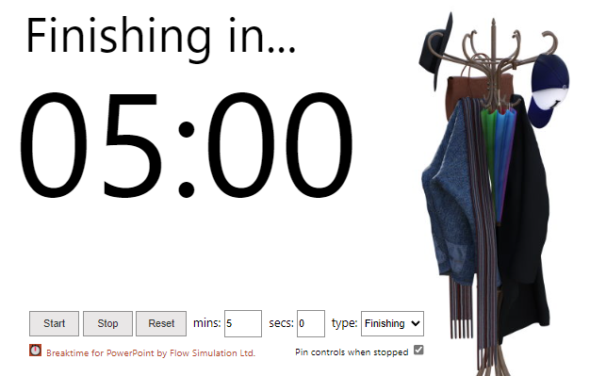
Break

Slide 23
Hotwash
For each discussion theme, identify the following:
  Strengths/Identified Best Practices
  Issues/Areas for Improvement
  Potential Corrective Actions
  Primary Responsible Organization
  Organization POC
  Next steps
Review any major themes
Identify any additional actions needed

Slide 24
Closing Remarks
[Name]
[Title]
[Organization/Jurisdiction]
This material was prepared by Health Quality Innovators (HQI), a Quality Innovation Network-Quality Improvement Organization (QIN-QIO) under contract with the Centers for Medicare & Medicaid Services (CMS), an agency of the U.S. Department of Health and Human Services (HHS). Views expressed in this material do not necessarily reflect the official views or policy of CMS or HHS, and any reference to a specific product or entity herein does not constitute endorsement of that product or entity by CMS or HHS. 12SOW/HQI/QIN-QIO-0853-08/21/24

